Slide 1

Functional Principles for Object-Oriented Developers
Jessica Kerr
@jessitron
Notes:
I am not going to tell you how to do functional programming. The objective is to write clear, readable, maintainable, high-quality code in an OO language. Functional principles have some ideas for us about how to do that.

Slide 2


What do we love about OO?
Notes:
Stuff about the hype it had way back when Java was new:
We were going to grab objects off the shelf and plug them together like tinker toys and wa-la, applications would emerge.

Slide 3

Functional programming will solve all our problems
Notes:
Functional programming is yet another way to solve problems, providing its own kind of glue, its own ways of putting the pieces together.

Slide 4
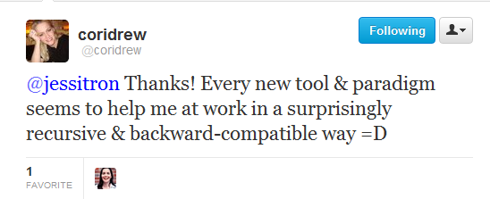

Slide 5
Programming paradigms
Imperative
Procedural
Object-Oriented
Functional
Aspect-oriented
Logic
Notes:
Wikipedia lists over 25 programming paradigms.
Each paradigm is suited to a particular problem set.
Each presents its own way of solving problems. The more we know, the more tools we have – not necessarily to use to solve the problem, either. We have more ways of thinking about the problem.

Slide 6
Data In, Data Out
Immutability
Verbs Are People Too
Declarative Style
Specific Typing
Lazy Evaluation

Slide 7

Principle
C# Java
What is it?
F# Scala
We already do it
What’s the point?
Notes:
For each principle, we will see these six points.
Counterclockwise, people, because this talk is about learning new ways to think.

Slide 8


Data In, Data Out

Slide 9

What’s the point?
Testable
Easier to understand
Notes:
The real reason is to reduce the moving parts.

Slide 10
Data In -> ? -> Data out
input
output
Notes:
The point is: for every variable you change to an immutable value, that’s one fewer thing you have to hold in your head.

Slide 11

good functions:
1. Don’t access global state
2. Don’t modify the input
3. Don’t bother the rest of the world
Notes:
Stateles s

Slide 12
What’s the point
Think about the data flow.
Notes:
Stateles s

Slide 13
Get unused deposits
Get unused donations
Create link record
Mark donation done
Deposit used up?

Slide 14
Get deposits
Get donations
unused
unused
List<Deposit>
List<Donation>
match
List<Match<Deposit,Donation>>
List<Donation>
Store matches
Mark donations

Slide 15
What’s the point?
Problem easier, because we know each step of the way of data.
Notes:
The real reason is to reduce the moving parts.

Slide 16

data in
public Account createAccount(UserDbService db,
String email,
String password) {
…
}
Notes:
body: boolean exists = db.AccountExists(email);
if (exists) { return “/forgotPassword”; }
if (invalidPassword(email, password)
{ return “/passwordAdvice”; }
db.CreateUser(email, password);
return “/welcome”;

Slide 17
data ?
string password;
string email;
private boolean invalidPassword() {
return !password.contains(email);
}

Slide 18
data in, data out
private boolean validatePassword(
string email,
string password)
{
return !password.contains(email);
}

Slide 19

Immutability

Slide 20
What is it?
You won’t change that object, because you can’t.
Notes:
The point is: for every variable you change to an immutable value, that’s one fewer thing you have to hold in your head.

Slide 21
What’s the point?
The less state that can change, the less you have to think about.
Concurrency!
Notes:
Locking is for wimps.
Concurrency is, frankly, a great excuse to favor immutability. The real reason is to reduce the moving parts.
Functional programming tries to reduce moving parts; OO tries to hide them inside of objects. We can do better: we can do both.

Slide 22

We already do it
String
Effective C#
Effective Java
Notes:
In Effective C#, Bill recommends only making atomic types immutable, but I advocate for most or all types to be immutable. Yes, go to the trouble of cloning on mod.
“Your ﬁrst choice for types that store data should be immutable, atomic value types.”

Slide 23
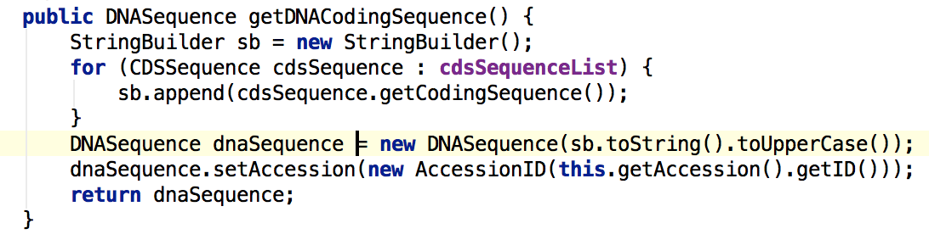
What’s the point?
NPE
Notes:
public DNASequence getDNACodingSequence() {
StringBuilder sb = new StringBuilder();
for (CDSSequence cdsSequence : cdsSequenceList) {
sb.append(cdsSequence.getCodingSequence());
}
DNASequence dnaSequence = new DNASequence(sb.toString().toUpperCase());
dnaSequence.setAccession(new AccessionID(this.getAccession().getID()));
return dnaSequence;
}private AccessionID accession;
public void setAccession(AccessionID accession) {
this.accession = accession;
}

Slide 24
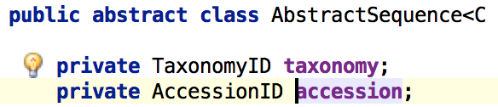
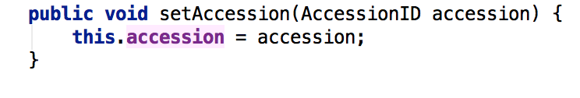
c
c

Slide 25

Scala
val four = 4 // immutable
var n = 2 // mutable
Notes:
Default mutability is accidental complexity.

Slide 26
F#
let four = 4 // immutable
let mutable n = 2 // mutable
n = 4 // false
n <- 4 // “destructive update”
Notes:
Default mutability is accidental complexity.

Slide 27
Java: easy
public struct Address {
private String city;
public Address(string city) {
this.city = city;
}
public string getCity() {
return city;
}
Notes:
Is private the default field access? Is my constructor syntax right? Does this give a compiler error if not init-ed in constructor?

Slide 28
C#: defensive copy
public class Customer {
private readonly IEnumerable<Phone> phoneNumbers;
public Customer(IEnumerable phones) { this.phones = new List(phones);
}
Notes:
Is this right?
Points: 1) Ienumerable because it can’t be modified
2) Copy it, because it is not final – we might be passed a mutable object
3) Phone must also be immutable. All the way down the composition chain, we need immutable reference types, or else FAILURE.
This is why default mutability is a negative. Default mutability is accidental complexity.

Slide 29

Java: defensive copy
private final ImmutableList<Phone> phones;
public Customer (Iterable<Phone> phones) {
this.phones = ImmutableList.copyOf(phones);
}
Notes:
Does this work?
There’s a library FSharpx that makes this prettier.

Slide 30
C#: copy on mod
public Customer AddPhone(Phone newPhone) {
List<Phone> morePhones =
new List(this.phones);
morePhones.Add(newPhone);
return new Customer(morePhones);
}
Notes:
Transition: and we’re copying lists all over the place. Immutable -> more copying

Slide 31
Java: copy on mod
public Customer addPhone(Phone newPhone) {
Iterable<Phone> morePhones =
ImmutableList.builder()
.addAll(phones)
.add(newPhone).build();
return new Customer(morePhones);
}
Notes:
Transition: and we’re copying lists all over the place. Immutable -> more copying

Slide 32

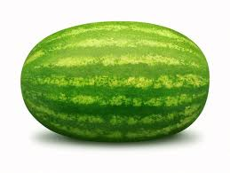



Immutable linked list
fruit
fruit.add(tomato)
Notes:
Functional programming deals often with list processing.
Think of it as a pipeline.
Because the original list is immutable, adding to the beginning does not copy the list.

Slide 33
Scala: copy on mod
def addPhone (newPhone : Phone) = {
new Customer(newPhone :: phones)
}
Notes:
Confirm: can use F#’s list in C#

Slide 34
F#: copy on mod
member this.AddPhone (newPhone : Phone) {
new Customer(newPhone :: phones)
}
Notes:
Confirm: can use F#’s list in C#

Slide 35
F# in C#
private readonly FSharpList<Phone> phones;
public Customer (IEnumerable<Phone> phones) {
this.phones = SeqModule.ToList(phones);
}
public Customer AddPhone(Phone newPhone) {
return new Customer(
FSharpList<Phone>.Cons(newPhone, phones))
}
Notes:
Does this work?
There’s a library FSharpx that makes this prettier.

Slide 36
C#: copy on mod
public Customer AddPhone(Phone newPhone) {
IEnumerable<Phone> morePhones =
// create list, or cons
return new Customer(morePhones, name, address, birthday, cousins);
}
Notes:
This would be a great time for a story or a joke or something.

Slide 37
Java: copy on mod
public Customer addPhone(Phone newPhone) {
List<Phone> morePhones =
// create list
return new Customer(morePhones, name, address, birthday, cousins);
}
Notes:
This would be a great time for a story or a joke or … a Commercial!

Slide 38
this talk is brought to you by… the Option type!
NPE
Thing
doStuff()
Option<T>
SomeThing
doStuff() {…}
Some<T>
NullThing
doStuff() {}
None

Slide 39
FSharpOption<T>
Optional<T>
… because null is not a valid object reference.
Notes:
someday, make the second line curve the

Slide 40
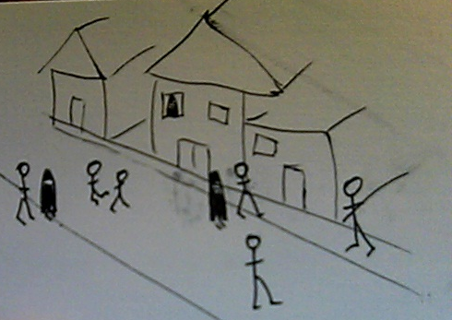

Verbs are people too
Notes:
Mention somewhere: we can abstract above the Von Neumann architecture. We don’t have to turn the problem into computer language anymore. We need to write about the problem in problem space.

Slide 41
What is it?
Functions are values.
Pass ‘em around
Notes:
Example of the Pricing Engine
This lets us separate the “how” from the “what.” basically, encode some design patterns.

Slide 42
We already do it
Strategy pattern
Command pattern
Callbacks
How
What
Notes:
HTTP
Every time we start a thread
onClick events to buttons
Dependency injection

Slide 43


We already do it
release ( )
OnClick()
Notes:
Javascript, we do this all the time.

Slide 44
What’s the point?
Passing around instructions is useful.
Notes:
Why, just yesterday I hit an instance where I needed to pass in how to implement one piece of an operation.
This can replace the template pattern or the strategy pattern.

Slide 45
Function types
Java: Runnable
Callable
Function<Integer, String>
Scala: Integer => String

Slide 46
Function types
C#: public delegate string CustomDelegate(string s, int i);
C#: Func<string, int, string>
Java: Function<Integer, String>
F#: string -> int -> string

Slide 47
Java
class CostInflation implements FunctionOverTime
{
public float valueAt(int t) {
return // some calculated value;
}
}
Notes:
Mention testability. When you’re passing in the method to call, you don’t have to mock an object.

Slide 48
Scala
val costInflation = Variable (
“Cost Inflation”, t => Math.pow(1.15,t))
let seasonalVolume = Array(0.95,0.99,1.01,…)
let seasonalAdjustment = Variable(“Season”,
t => seasonalVolume(t))
Notes:
this example needs:
type Something = | Variable of string * (int -> float)
let valueAt (Variable(_,calc)) (t:int) = calc t

Slide 49
F#
let costInflation = Variable (
“Cost Inflation”, fun t -> pown 1.15 t)
let seasonalVolume = [| 0.95; 0.99; 1.01,…|]
let seasonalAdjustment = Variable(“Season”,
fun t -> seasonalVolume.[t % 12])
Notes:
this example needs:
type Something = | Variable of string * (int -> float)
let valueAt (Variable(_,calc)) (t:int) = calc t

Slide 50
C#
private readonly Func<int, double> calc;
public Func<int, double> ValueAt
{
get { return calc; }
}
Notes:
Mention testability. When you’re passing in the method to call, you don’t have to mock an object.

Slide 51
C#
var inflation = new Variable(“Inflation”,
t => Math.Pow(1.15,t));
inflation.ValueAt(3);
Notes:
Mention testability. When you’re passing in the method to call, you don’t have to mock an object.

Slide 52
Java
Variable inflation = new Variable (“Inflation”,
new Function<Integer, Double>() {
@Override
public Double apply(Integer input)
{
return Math.pow(1.15, input);
}
});
Notes:
Mention testability. When you’re passing in the method to call, you don’t have to mock an object.

Slide 53
Java 8
Variable inflation = new Variable
(“Inflation”,
t => Math.pow(1.15, t)
);
Notes:
Mention testability. When you’re passing in the method to call, you don’t have to mock an object.

Slide 54

Declarative style
Notes:
Mention that much of what we call functional programming is now better described as “expression-oriented”

Slide 55
What is it?
Say what you’re doing, not how you’re doing it.
Notes:
Rich Hickey: "Strictly separating what from how is the key to making ‘how’ somebody else's problem."

Slide 56
We already do it
short methods with meaningful names
Notes:
Put an example in here! or a quote or something

Slide 57
We already do it
Select ROLE_NAME, count(*), max(update_date)
From USER_ROLES
Where USER_ID = :userId
Group by ROLE_NAME
Notes:
Excel is another example. We specify the relationships between the cells, not the order of calculation. LINQ, of course.

Slide 58
What’s the point?
Readable code
Smaller, simpler pieces
Familiar != readable
Notes:
Point out that we can separet the “what” from the “how” better because of the verbs. We can pass the “what” around into fucntions that know the “how”.

Slide 59
Java
List<String> output = new LinkedList();
for(String s : lines) {
if(s.startsWith(“BUG”)) {
output.add(s);
}
}
return output;
Notes:
Point out that we can separet the “what” from the “how” better because of the verbs. We can pass the “what” around into fucntions that know the “how”.

Slide 60
F#
List.filter
(fun (s:string) -> s.StartsWith(“BUG"))
lines
Notes:
Show a filter

Slide 61
Scala
lines.filter( _.startsWith(“BUG”))
Notes:
Show a filter

Slide 62

Java
filter(list, startsWithBug);
final Predicate<String> startsWithBug =
new Predicate<String>() {
public boolean apply(String s) {
return s.startsWith("BUG");
}
};
Notes:
Guava makes the filter operation one line, BUT you have to define the predicate as an anonymous class.
(define predicate)
What was twenty characters in Scala is five or six lines of code in Java, with curly braces and pointy braces and parentheses.

Slide 63
C#
lines.Where(s => s.StartsWith(“BUG”)).ToList()
Notes:
You have to think about this. You have to follow the logic and picture it in order to name what it is doing.
This is very readable BECAUSE IT IS FAMILIAR.
We have the power to create new idioms!

Slide 64
this talk is brought to you by… the Tuple type!
function
new Tuple<string,int>(“You win!”, 1000000)

Slide 65
Tuple<T1,T2,…>
When one return value is not enough!

Slide 66

Specific typing
Notes:
String typing

Slide 67
What is it?
Static typing +
Strong typing +
Be specific
Notes:
It’s finding errors at compile-time instead of at runtime.
The more specific we are with the type of data, the more the compiler can help us.

Slide 68
What is it?
instead of:
Notes:
It’s finding errors at compile-time instead of at runtime.
The more specific we are with the type of data, the more the compiler can help us.

Slide 69
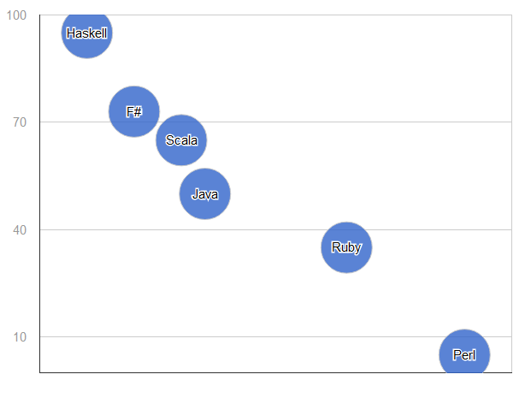
What’s the point?
% errors found at compile-time
Typing
Notes:
Type Safety.
Catch errors as early as possible.
Provide meaning to data.
Encapsulation, while we’re at it.

Slide 70

We already do it
Notes:
Emphasizes creating a language to describe the domain, and carefully naming each type in the system.

Slide 71
What’s the point?
The beginning of wisdom is to call things by their right names.
Notes:
Type Safety.
Catch errors as early as possible.
Provide meaning to data.
Encapsulation, while we’re at it.

Slide 72
We already do it
Java
C#
is strongly typed, right?
Notes:
Well, it is statically typed. How we use that is up to us.
When we pass in a firstname and the type is string, we’re not specifying what the object is. string is not the meaning of that data – it is how the data is stored.
Erasure messes up runtime type checking.

Slide 73
Haskell
type FirstName = String // type alias
data Customer = Customer FirstName EmailAddress
Notes:
They say about Haskell, if you can get your program to compile, it’s probably right.
Catch the errors early, dammit.
There’s being picky about what we want, and then there’s being specific about what we want.

Slide 74
F#
[<Measure>] type cents
let price = 599<cents>
Notes:
There’s being picky about what we want, and then there’s being specific about what we want.

Slide 75
Scala
type FirstName = String // type alias
Customer(name : FirstName, home : EmailAddress)
Notes:
They say about Haskell, if you can get your program to compile, it’s probably right.
Catch the errors early, dammit.
There’s being picky about what we want, and then there’s being specific about what we want.

Slide 76
Scala
case class FirstName(value : String)
let friend = FirstName(“Onorio”);
Notes:
They say about Haskell, if you can get your program to compile, it’s probably right.
Catch the errors early, dammit.
There’s being picky about what we want, and then there’s being specific about what we want.

Slide 77
F#
type FirstName = | FirstName of string
let friend = FirstName(“Onorio”);
Notes:
They say about Haskell, if you can get your program to compile, it’s probably right.
Catch the errors early, dammit.
There’s being picky about what we want, and then there’s being specific about what we want.

Slide 78
Strong typing in Java
public User(FirstName name, EmailAddress login)
public class FirstName { public final String stringValue; public FirstName(final String value) { this.stringValue = value; } public String toString() {...} public boolean equals() {...} public int hashCode() {...} }
Notes:
Benefits:
It is not true that “first name is a string.” Rather, “First name is _stored as_ a string.”
Arguments are more specific
Put validations in the particular types
You know when you switched the order – compile error
If you ever do need to change the underlying type, or the validations, or add a field, you have a place to do that. (Encapsulation)

Slide 79
Strong typing in Java
new User(firstName(“Onorio”),
emailAddress(“Catenacci@ieee.org”));
public static FirstName firstName(String value)
{
return new FirstName(value);
}
Notes:
Sure, it is a lot of cruft. But it has a purpose. Think hard about how important correctness is in your program.
Interesting contrast: C# won’t let you import the static method like Java does. But, you can create an implicit conversion.

Slide 80
C#
class FirstName {
private readonly string value;
public FirstName(string value)
{ this.value = value; }
public static implicit operator FirstName(string value)
{
return new FirstName(value);
}
}
Notes:
Specificness is another part of strong typing.

Slide 81
C#
public Customer(FirstName name,
EmailAddress login) {…}
new Customer(“Jay”, (EmailAddress)“jay@aranasoft.com”);
Notes:
Specificness is another part of strong typing.

Slide 82
What is it?
State everything you need
State only what you need
Notes:
It’s finding errors at compile-time instead of at runtime.
The more specific we are with the type of data, the more the compiler can help us.

Slide 83
Scala
List [+A]
def indexOf [B >: A] (elem: B): Int
def sameElements (that: GenIterable[A]): Boolean

Slide 84
Java: vague
public boolean valid(Customer cust)
{
EmailAddress email = cust.getEmailAddress;
// exercise business logic
return true;
}
Notes:
Specificness is another part of strong typing.

Slide 85
Java: specific
public bool valid(HasEmailAddress anything)
{
EmailAddress email = anything.getEmailAddress();
// exercise business logic
return true;
}
interface HasEmailAddress {
String EmailAddress getEmailAddress();
}
Notes:
This is more specific.

Slide 86
C#: weak
public boolean Valid(Customer cust)
{
EmailAddress email = cust.EmailAddress;
// exercise business logic
return true;
}
Notes:
Specificness is another part of strong typing.

Slide 87
C#: specific
public boolean Valid(IHasEmailAddress anything)
{
EmailAddress email = anything.EmailAddress;
// exercise business logic
return true;
}
interface IHasEmailAddress {
string EmailAddress {get; }
}
Notes:
This is more specific.

Slide 88
this talk is brought to you by… the Choice type!
You lose – busted!
Congratulations! $200

Slide 89
Either<A,B>
Choice<T1,T2>
because checked exceptions are the devil

Slide 90

Lazy evaluation

Slide 91
What is it?
Delaying evaluation of an expression until the last responsible moment.
Notes:
Laziness as a programmer virtue

Slide 92
We already do it
Providers, Factories
SQL Cursors
Notes:
Pass around how to get something, instead of getting it every time.
Of course we do lazy initialization, such as in Hibernate. But that bites us because we’re not passing the full “how to do it” back to the remote-invocation system.
LINQ expressions work like this, passing around the “how.” this can burn you, because they get evaluated again at each access
C# 4.0 has a Lazy<T>.
Futures are another example.

Slide 93
What’s the point?
You may never even need it.
Separate “what to do” from “when to stop.”
Notes:
Instead of passing around the result of some calculation, we’re passing around how to get that result.
Two result expressions in a conditional – one of those will never be used.

Slide 94
Lazy evaluation in Java
Callable
Iterable

Slide 95
Imperative Java
int bugCount = 0;
String nextLine = file.readLine();
while (bugCount < 40) {
if (nextLine.startsWith("BUG")) {
String[] words = nextLine.split(" ");
report("Saw the bug at "+words[0]+" on "+ words[1]);
bugCount++;
}
waitUntilFileHasMoreData(file);
nextLine = file.readLine();
}

Slide 96
Functional style
for (String s :
FluentIterable.of(new RandomFileIterable(br)) .filter(STARTS_WITH_BUG_PREDICATE)
.transform(TRANSFORM_BUG_FUNCTION)
.limit(40)
.asImmutableList()) {
report(s);
}

Slide 97
C#: Imperative Style
int bugCount = 0;
string nextLine = file.ReadLine();
while (bugCount < 40) {
if (nextLine.StartsWith("BUG")) {
string[] words = nextLine.Split(' ');
Report("Saw the bug at " + words[1]
+ " on " + words[2]);
bugCount++;
}
WaitUntilFileHasMoreData(file);
nextLine = file.ReadLine();
}

Slide 98
C#: Declarative style
var lines = ReadLines(file)
.Where(line => line.StartsWith("BUG"))
.Select(FormatBugLine)
.Take(40);
foreach (var line in lines)
{
Report(line);
}

Slide 99
C#: Lazy & Declarative
IEnumerable<string> ReadLines(StreamReader r) {
while (true) {
WaitUntilFileHasMoreData(r);
yield return r.ReadLine();
}
}

Slide 100
Data In, Data Out
Immutability
Verbs Are People Too
Declarative Style
Specific Typing
Lazy Evaluation

Slide 101
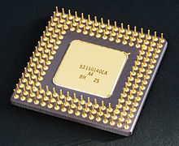

Haskell
Assembly
C
Prolog

Slide 102
Alistair Cockburn’s Oath of Non-Allegiance
I promise not to exclude
from consideration any idea
based on its source, but to consider ideas across schools and heritages
in order to find the ones that best suit the current situation.
Notes:
http://alistair.cockburn.us/Oath+of+Non-Allegiance

Slide 103
Optional<T>
Tuple<T>

Slide 104























Slide 105
Jessica Kerr @jessitron
blog.jessitron.com
github.com/jessitron/fp4ood
Man, the living creature, the creating individual, is always more important than any established style or system. – Bruce Lee

